Slide 1
West Nile Virus in Chicago
Martim Lobao
Harrison Connelly
Owen Callen

Slide 2

Problem: WNV Spreading
Cases 2017
Treatment
Prevalence
Spread

Slide 3
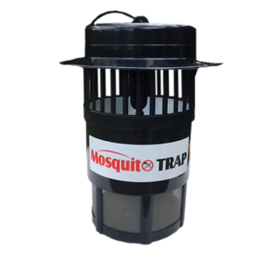
Data
Trapped
Spray
Date
Latitude & Longitude
Weather
Altitude
Daylight Time
Notes:
Counted, Classified and Grinded
Spray Location, Date, Time 2013

Slide 4
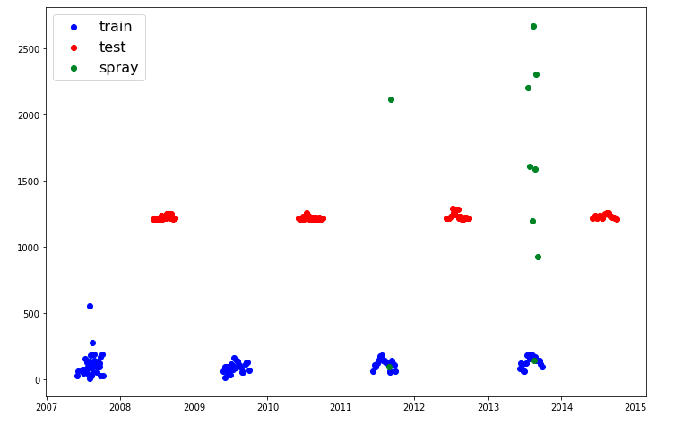
Spraying History

Slide 5
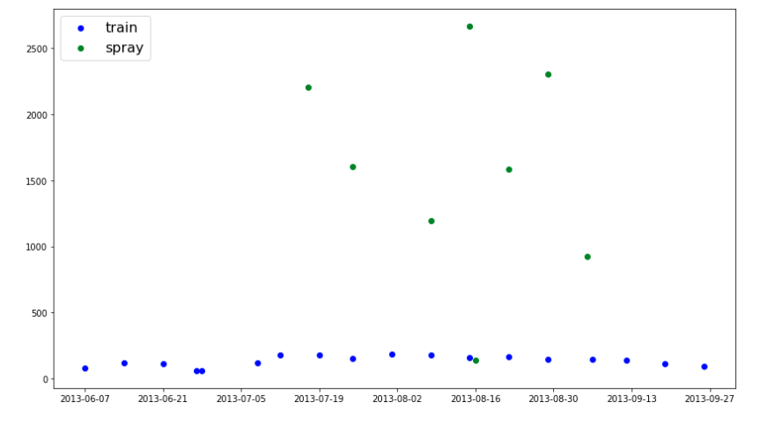
Spraying - 2013

Slide 6

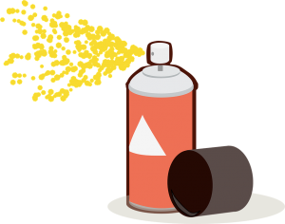

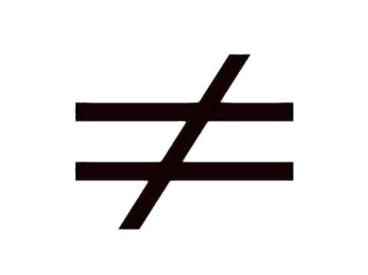

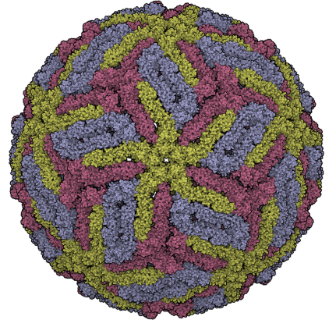
Problem Spraying
=
Notes:
Reduce Population Slightly
Does not Reduce Prevalence of WNV

Slide 7
Philosophy
2013 Spray Data
2007 through 2015
Over Sampling
Feature Engineering
Built a Model

Slide 8
2007 to 2015 Logistic Model
 | Train | Test
Accuracy | 85.8% | 91.8%
F1-Score | 46.5% | 37.4%
Neg Predictive Power | 88.4% | 95.9%
Pos Predictive Power | 62.1% | 35.8%
Sensitivity | 37.2% | 39.1%
Specificity | 95.5% | 95.3%

Slide 9
Logistic Confusion Matrix
 | Actual Positive | Actual Negative
Predicted Positive | 492 | 300
Predicted Negative | 831 | 6,318

Slide 10
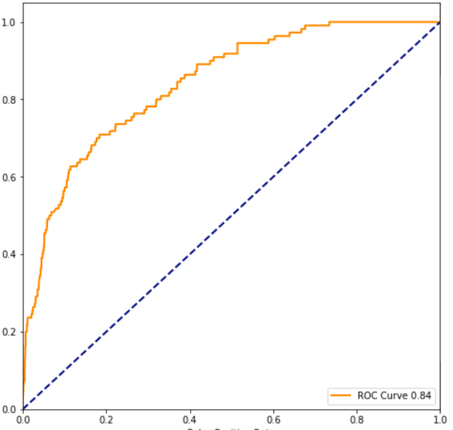
AUC ROC Curve

Slide 11

What to do?
Notes:
Warn People

Slide 12
Cost Benefit Analysis
Spraying
Not worked
Continued Monitoring and Warning
2017
8 Deaths
90 Human Cases ~ $135,000 Per year
Researchers $70,000 Per Person + Trap Locations ~ $1,000,000
Project High Cost to Maintain
Notes:
Only 1 Year Possibility
4 out of 5 people do not show symptoms
Love to spend more time on the problem to see different important factors that are relevant
This is what is reported. Not everything

Slide 13
Thank You

